Slide 1

Bayesian model on score distributions of NFL teams Exploration & Prediction

Slide 2
Background
Regular season (Sep-Jan): 256 games, calculating standing based on W/L/T percentage
Playoff season (Jan-Feb): 11 elimination games (13 games starting 2020), including the final Super Bowl
2 conferences, 4 divisions each, 4 teams each. Total 32 teams.

Slide 3
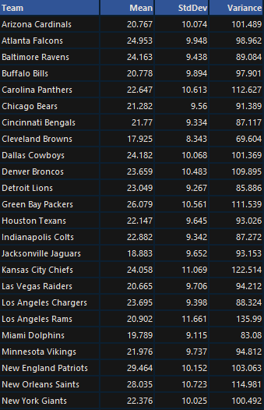

Slide 4
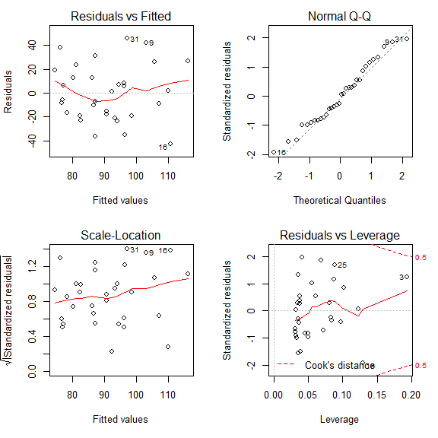
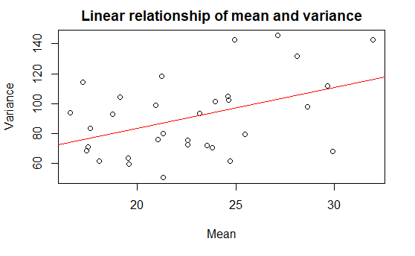
Set up mean and variance correlation
A simple linear model suggests
Variance = 29.017 + 2.731 x Mean

Slide 5
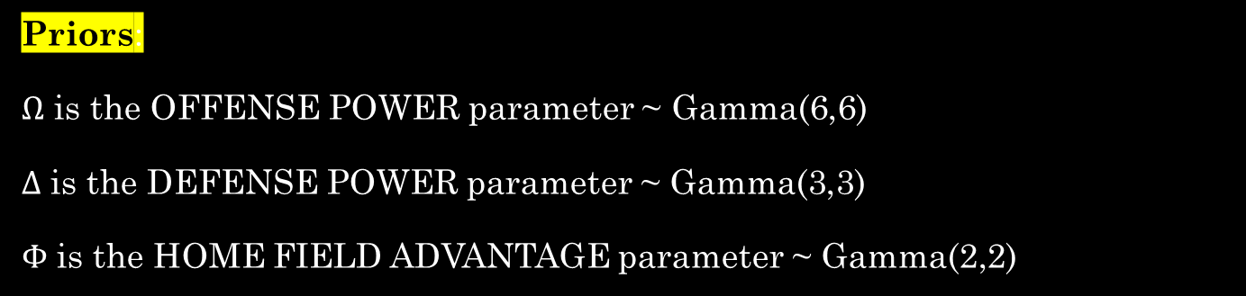

Priors and likelihood functions
$$Mean score =αβ=Ω_{i}−Δ_{j}+Φ_{i}×\left(±1\right)$$
$$Score variance=αβ^{2}=29.017+2.731×Mean$$
For example, in a game where team i meets team j at i’s home field:
$$Score_{i}∼Gamma\left(α_{i},β_{i}\right)$$
$$where α_{i}β_{i}=Ω_{i}−Δ_{j}+Φ_{i}$$
$$and α_{i}β_{i}^{2}=29.017+2.731×α_{i}β_{i}$$
$$Score_{j}∼Gamma\left(α_{j},β_{j}\right)$$
$$where α_{j}β_{j}=Ω_{j}−Δ_{i}−Φ_{j}$$
$$and α_{j}β_{j}^{2}=29.017+2.731×α_{j}β_{j}$$
Priors:
$Ω$ is the OFFENSE POWER parameter ~ Gamma(6,6)
$Δ$ is the DEFENSE POWER parameter ~ Gamma(3,3)
$Φ$ is the HOME FIELD ADVANTAGE parameter ~ Gamma(2,2)

Slide 6




Priors and likelihood functions
An Example
Philadelphia Eagles vs. Washington Redskins
Philadelphia Eagles
O$ffense Ω$ = 35
Defense $Δ$ = 15
H$ome advantage Φ$ = 5
Washington Redskins
O$ffense Ω$ = 25
D$efense Δ$ = 10
H$ome advantage Φ$ = 2
i = Eagles vs. j = Redskins
$$Score_{i}∼Gamma\left(α_{i},β_{i}\right)$$
$$where α_{i}β_{i}=35−10+5=30$$
$$and α_{i}β_{i}^{2}=29.017+2.731×30=110.95$$
therefore $β$ = Variance/Mean = 3.7
and $α$ = Mean/ $β$ = 8.11
thus Eagles score ~ Gamma(8.11, 3.7)
$$Score_{j}∼Gamma\left(α_{j},β_{j}\right)$$
$$where α_{j}β_{j}=25 −15 −2=8$$
$$and α_{j}β_{j}^{2}=29.017+2.731×8=50.87$$
therefore $β$ = Variance/Mean = 6.36
and $α$ = Mean/ $β$ = 1.26
hence Redskins score ~ Gamma(1.26, 6.36)
In a game where team i meets team j at i’s home field:
$$Score_{i}∼Gamma\left(α_{i},β_{i}\right)$$
$$where α_{i}β_{i}=Ω_{i}−Δ_{j}+Φ_{i}$$
$$and α_{i}β_{i}^{2}=29.017+2.731×α_{i}β_{i}$$
$$Score_{j}∼Gamma\left(α_{j},β_{j}\right)$$
$$where α_{j}β_{j}=Ω_{j}−Δ_{i}−Φ_{j}$$
$$and α_{j}β_{j}^{2}=29.017+2.731×α_{j}β_{j}$$

Slide 7
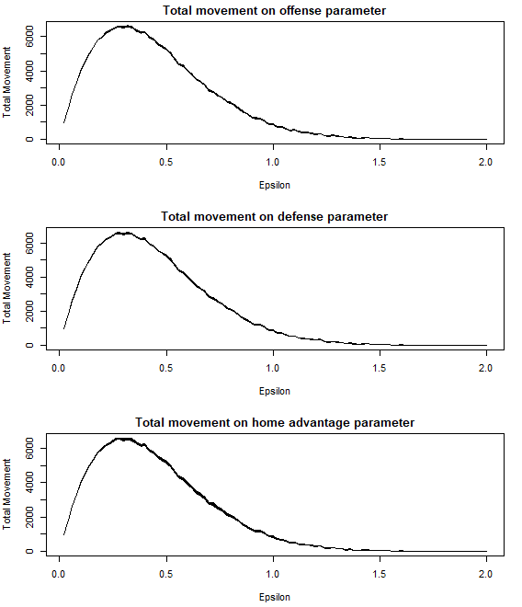
Epsilon value in Metropolis-Hastings algorithm
Run 100 different values of epsilon
0.02, 0.04, … , 2
Each time recording the total movement on each parameters of each team
Based on this simulation,
epsilon=0.32 for offense
epsilon=0.28 for defense
epsilon=0.28 for home advantage

Slide 8
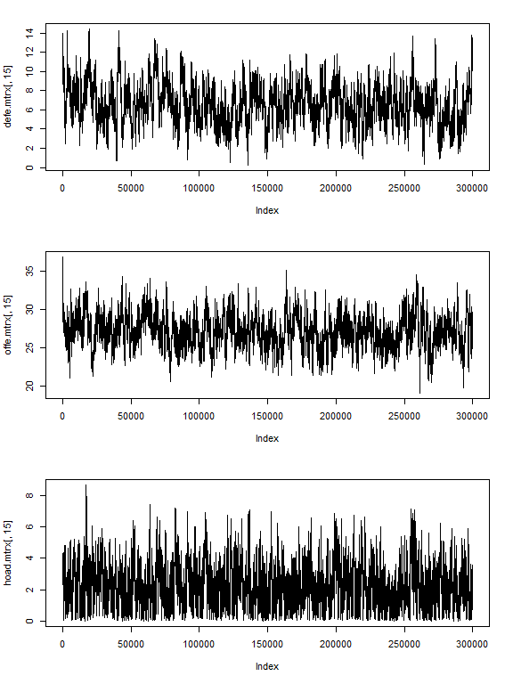
Metropolis-Hastings algorithm
300,000 steps
Acceptance rate = 46.50%
epsilon=0.32 for offense
epsilon=0.28 for defense
epsilon=0.28 for home advantage

Slide 10
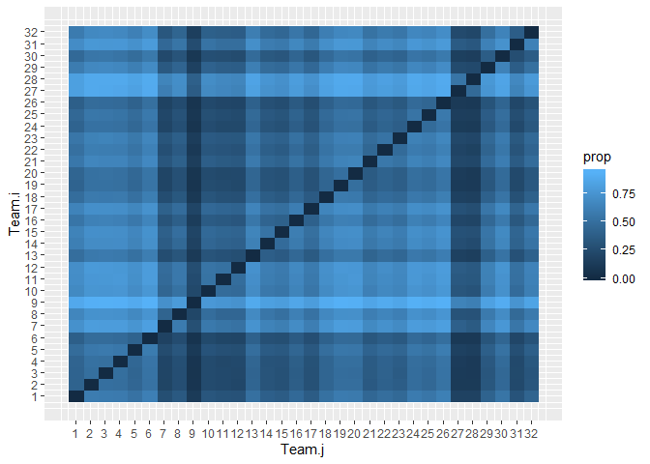
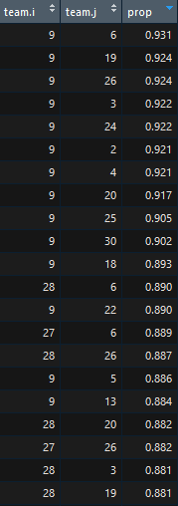
Is there a difference in home field advantage of 32 teams?
Heatmap of proportions from pairwise comparisons of home field advantage.
Each tile represents the chance/probability that team i has larger home advantage than team j.
Thus, not sufficient evidence to conclude a difference in home advantage of any 2 teams.

Slide 11
Predict NFL 2020 season champion based on our obtained estimated parameters

Slide 12
Predict NFL 2020 season champion based on our obtained estimated parameters
What will happen if we run 2019 season, but with 2020 regular season schedule?

Slide 13
Predict NFL 2020 season champion based on our obtained estimated parameters
What will happen if we run 2019 season, but with 2020 regular season schedule?
What would happen if we re-ran 2019 season, but with a regular season schedule that is amazingly similar to the 2020 schedule prepared by NFL?

Slide 14
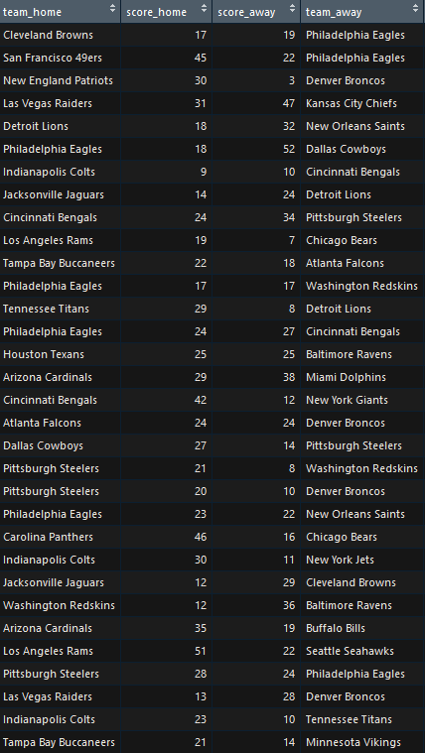
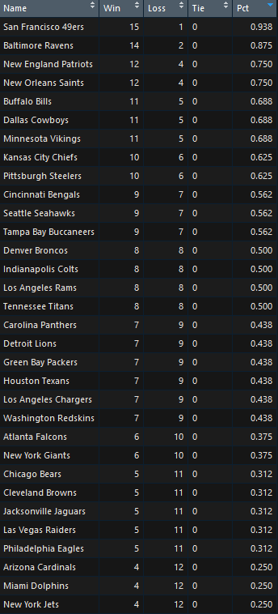

Slide 15
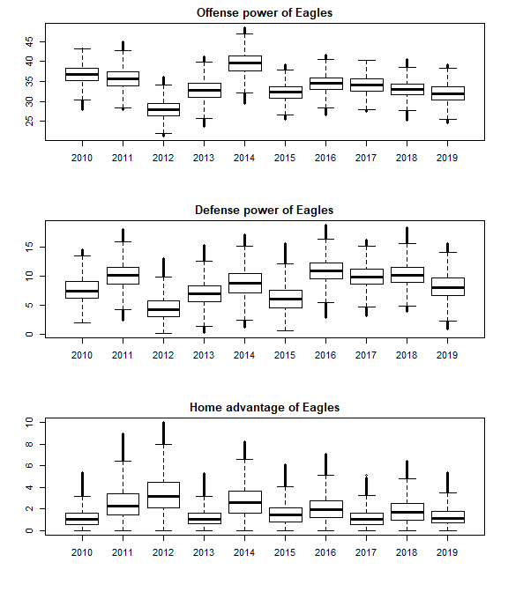
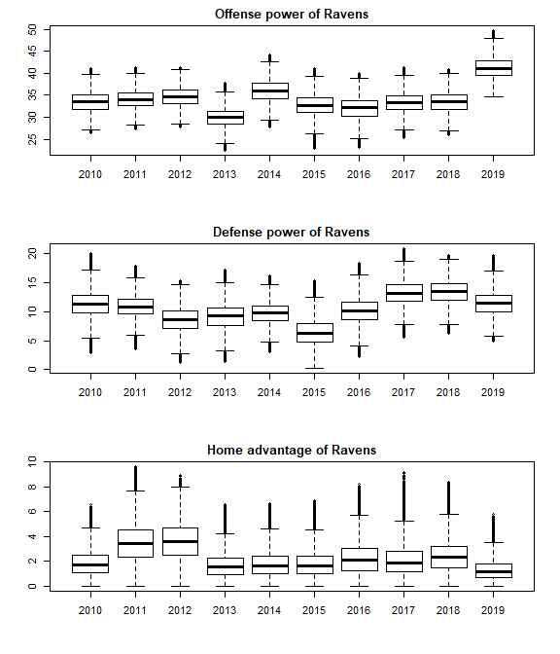

Slide 16
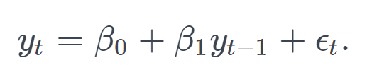
Autoregression on parameters over 2010-2019 period
An autoregressive model is when a value from a time series is regressed on previous values from that same time series.
Thus, I use autoregression model to predict 2020 parameters (Offense, Defense, Home Advantage) based on 2019 parameters from Bayesian model .

Slide 17
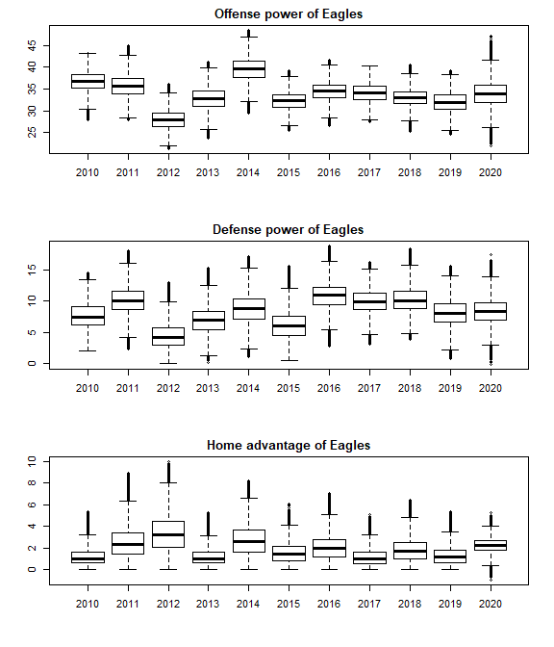

Slide 18
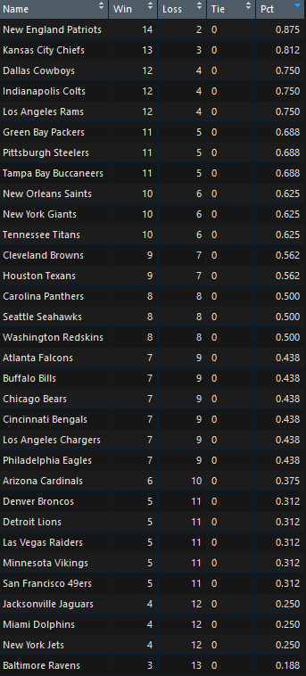
Predict NFL 2020 season champion based on our obtained estimated parameters

Slide 19
Comparison between results based solely on 2019 parameters and results based on parameters estimated with autoregression model

Slide 20
Q&A

